Slide 1

Students Details
Name: | Paritosh Bobade
SkillsBulid Email ID: | paritoshbobade@gmail.com
College Name: | Bharati Vidyapeeth College of Engineering, Pune
College State: | Maharashtra
Internship Domain: | Artificial Intelligence
StartDate: | 18 AUG 2023
End Date: | 30 SEP 2023

Slide 2

Problem Statement / Topic
Sentiment Analysis of Restaurant Reviews
In today's highly competitive restaurant industry, understanding and responding to customer sentiment is paramount for business success.
The problem at hand is to develop a robust sentiment analysis model that can accurately classify customer reviews of restaurants as positive, negative, or neutral.
The objective is to provide actionable insights to restaurant owners and managers, allowing them to understand customer feedback, improve customer satisfaction, and make data-driven decisions to enhance the overall dining experience.
Content

Slide 3

AGENDA
Sentiment Analysis of Restaurant Reviews
Introduction
Problem Statement
Project Overview
End Uses
Solutions and Its Value Proposition
Customization
Modelling
Results
Links
Content

Slide 4
PROJECT OVERVIEW
Sentiment Analysis of Restaurant Reviews
Introduction to Sentiment Analysis
Define sentiment analysis and its relevance to restaurant reviews.
Explain its applications in understanding customer feedback.
Data Collection and Preprocessing
Describe the data collection process for restaurant reviews.
Highlight the importance of data cleaning and preprocessing steps.
Text Analysis Techniques
Introduce feature extraction methods like TF-IDF and Count Vectorization.
Explain how these techniques convert text data into numerical form.
Model Selection
Discuss the choice of machine learning models such as Multinomial Naive Bayes and Random Forest.
Explain the rationale behind model selection.
Results and Graphs
Present key findings from the analysis, including sentiment distribution and frequent positive/negative words.
Highlight any interesting trends or patterns in restaurant reviews.
Content

Slide 5
END USERS
Sentiment Analysis of Restaurant Reviews
Targeted Audience:
Restaurant Owners/Managers: They can gain insights into customer feedback to improve service and menu offerings.
Customers: Seeking information on the quality of a restaurant's food and service.
Food Critics/Bloggers: Using sentiment analysis to support their reviews.
Researchers: Analyzing sentiment trends and patterns in restaurant reviews for academic or market research.
Food Delivery Services: Companies like food delivery apps use sentiment analysis to assess restaurant ratings and customer feedback to improve partner restaurant selections.
Investors: Investors in the restaurant industry may use sentiment analysis to gauge the public's perception of specific restaurant chains and make investment decisions.
Content

Slide 6
My Solution and Value Proposition
Sentiment Analysis of Restaurant Reviews
Solution :
I think the propose to develop a Sentiment Analysis tool for restaurant reviews which will automatically analyze and classify reviews into positive, negative, or neutral sentiments, helping both restaurant owners and fellow diners make decisions.
Value Proposition:
This Sentiment Analysis transforms restaurant reviews into actionable insights, making dining decisions easier for consumers, and providing restaurant owners with a competitive edge in the market. It also offers students valuable real-world experience in data analysis and machine learning.
Content

Slide 7
How did you personalize the project?
Sentiment Analysis of Restaurant Reviews
I have used my personal hands on experience and knowledge of language in the project.
I have used graphs and heatmap which we can understand data visually through data visualization .
I have used 3 models in my project which gives me different accuracy scores.
Multinomial Naive Bayes [77.5%]
Random Forest Classifier [74.5%]
Decision Tree Classifier [72%]
Along with training a model, I have used Hyperparameters Tuning which increases my score by 1% in the multinomial naive bayes model.
In the end of the the ppt, I have listed the GitHub repository and google colab links
Content

Slide 8
MODELLING
Sentiment Analysis of Restaurant Reviews
1). Multinomial Naive Bayes:
Multinomial Naive Bayes is a probabilistic classification algorithm commonly used in natural language processing (NLP) and text classification tasks.
This requires a supervised learning technique that classifies every new document by assigning one or more class labels from a fixed or predefined class.
It provides an alternative to the "heavy" AI-based semantic analysis and drastically simplifies textual data classification.
Naive Bayes which is computationally very efficient and easy to implement
Advantages:
Low computation cost.
It can effectively work with large datasets.
For small sample sizes, Naive Bayes can outperform the most powerful alternatives.
Easy to implement, fast and accurate method of prediction.
Naive Bayes is used in prediction of weather reports based on atmospheric conditions (temp, wind, clouds, humidity etc.)
Content

Slide 9
MODELLING
Sentiment Analysis of Restaurant Reviews
2). Random Forest Classifier:
Random Forest is one of the popular machine learning algorithm that belongs to the supervised learning technique.
Random Forest is a classifier that contains a number of decision trees on various subsets of the given dataset and takes the average to improve the predictive accuracy of that dataset.
The greater number of trees in the forest leads to higher accuracy and prevents the problem of overfitting.
The random forest algorithm provides a higher level of accuracy in predicting outcomes over the decision tree algorithm.
Advantages:
Random Forest is capable of performing both Classification and Regression tasks.
It is capable of handling large datasets with high dimensionality.
It enhances the accuracy of the model and prevents the overfitting issue.
Easy to implement, method of prediction.
It works well with both categorical and continuous values.
Content

Slide 10
MODELLING
Sentiment Analysis of Restaurant Reviews
3). Decision Tree Classifier:
A Decision Tree Classifier is a supervised machine learning algorithm used primarily for classification tasks.
They use the values in each feature to split the dataset to a point where all data points that have the same class are grouped together.
A decision tree is a non-parametric supervised learning algorithm, which is utilized for both classification and regression tasks.
Their most important feature is the capability of capturing descriptive decisionmaking knowledge from the supplied data.
Advantages:
Decision trees can be used to predict both continuous and discrete values
Requires little data preparation. Other techniques often require data normalization, dummy variables,etc
Able to handle both numerical and categorical data.
They work well in both regression and classification tasks.
As decision trees are simple hence they require less effort for understanding an algorithm.
Content

Slide 11
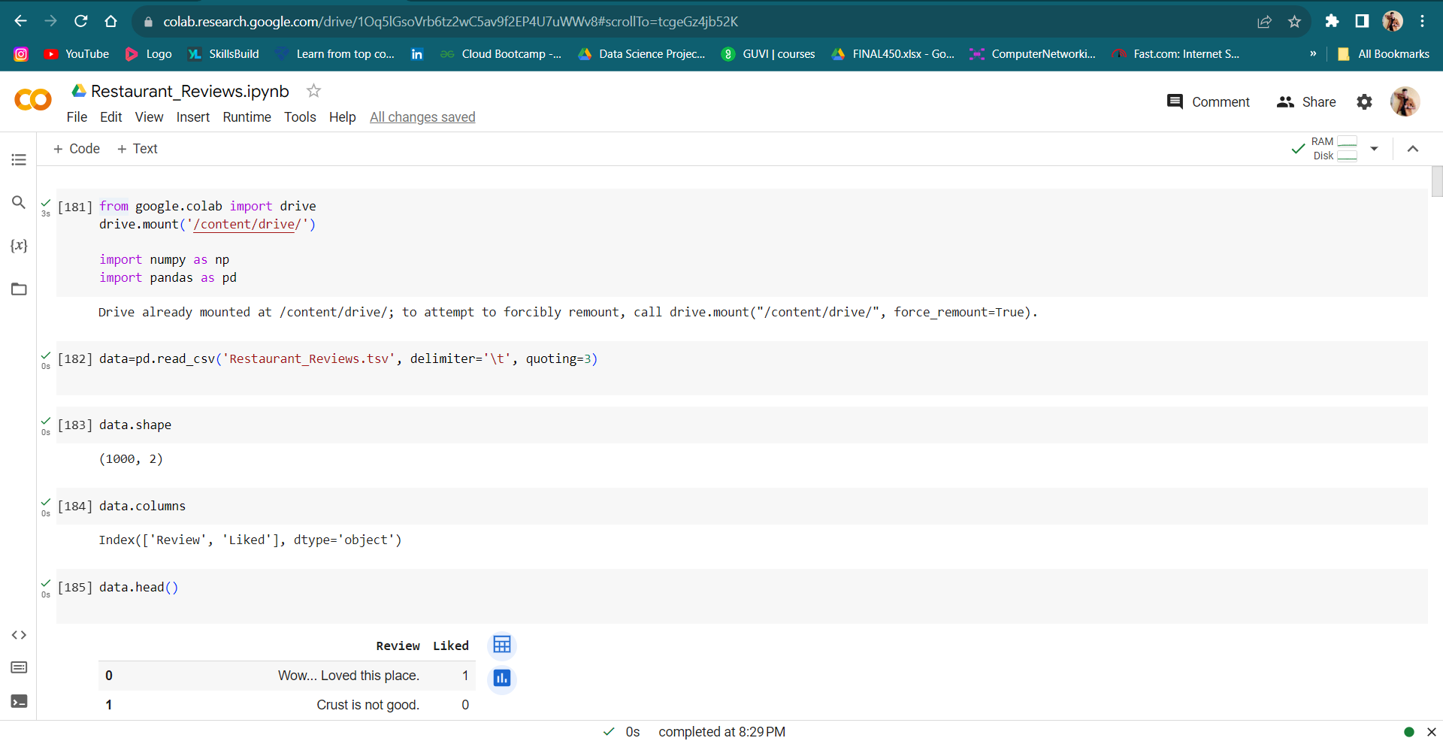
SCREENSHOTS

Slide 12
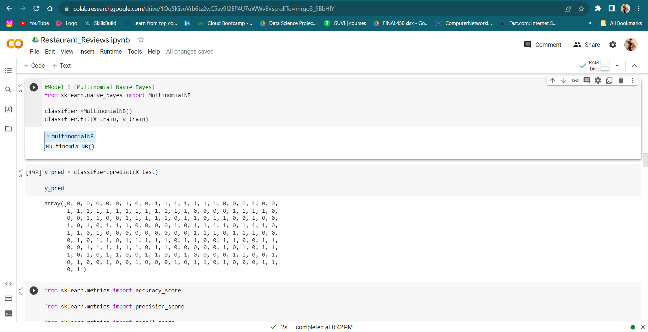
SCREENSHOTS

Slide 13
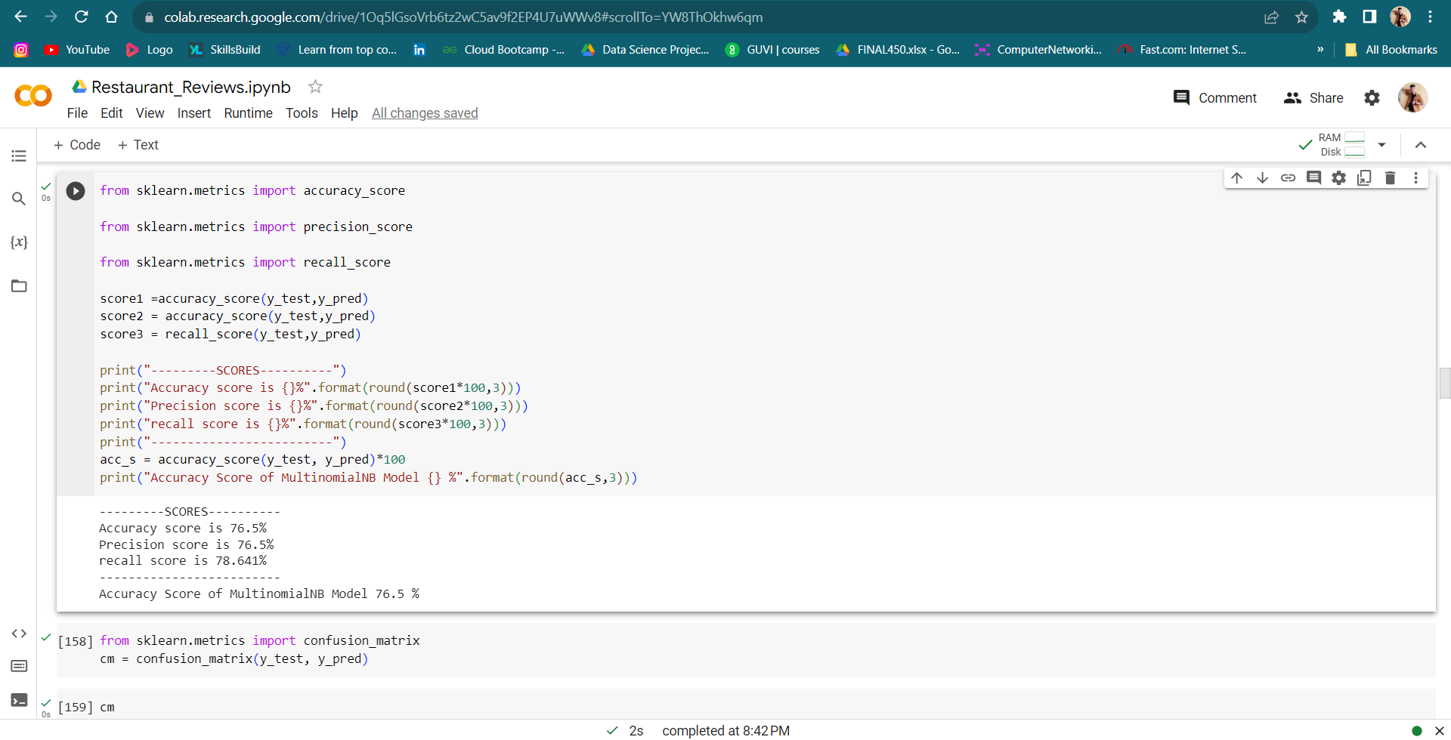
RESULTS
Multinomial Naive Bayes Accuracy =76.5%

Slide 14
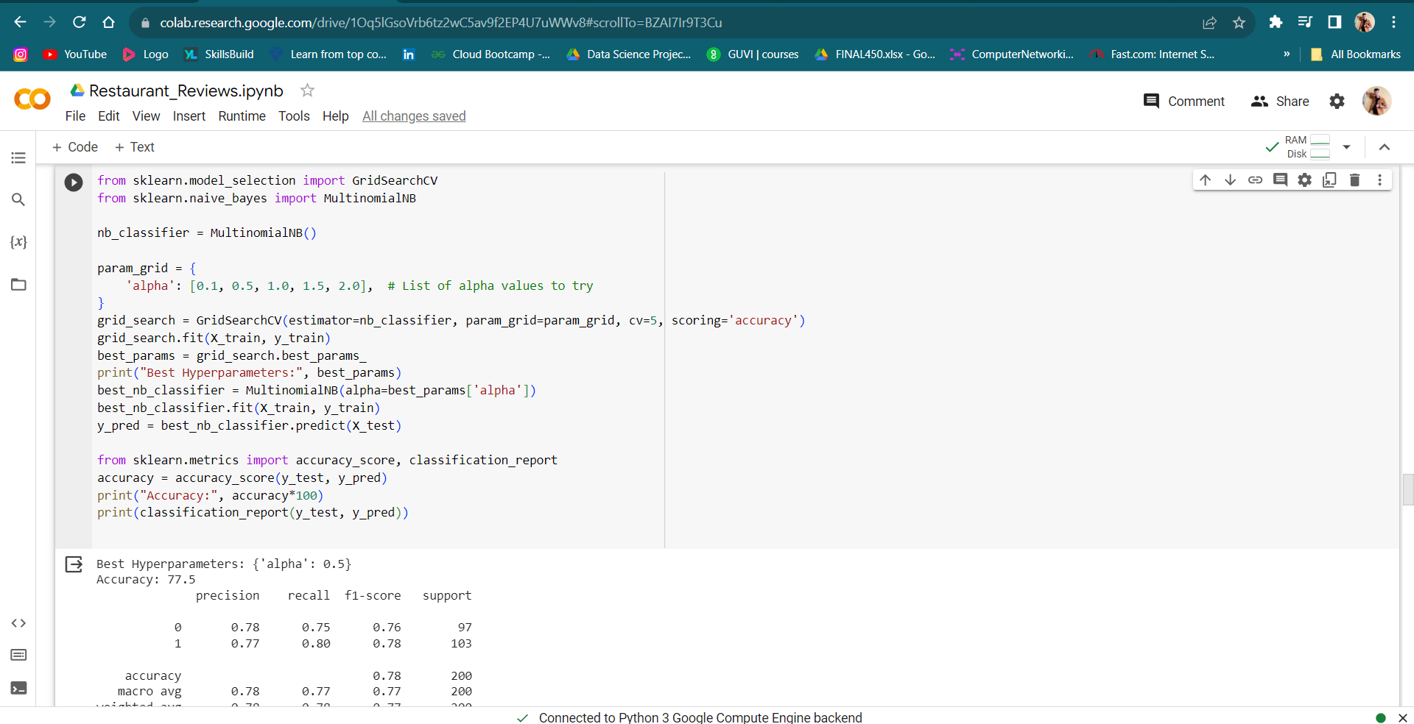
RESULTS
After Hyperparameter tuning Accuracy =77.5%

Slide 15
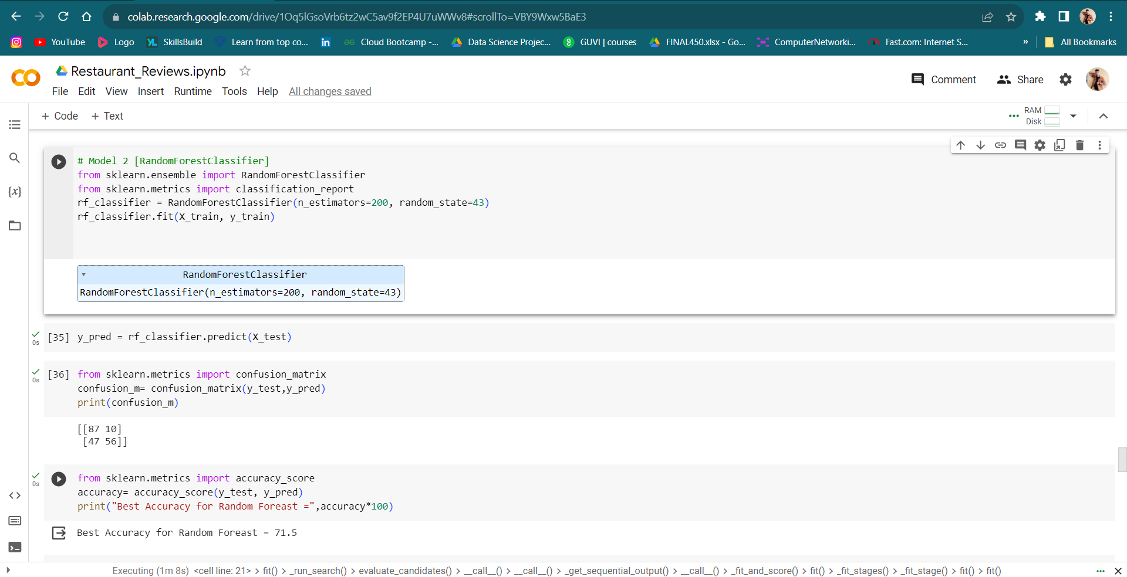
RESULTS
Random Forest Classifier

Slide 16
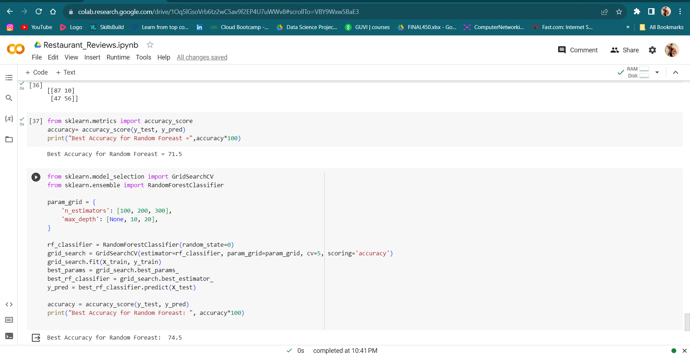
RESULTS
Random Forest Accuracy =74.5%

Slide 17
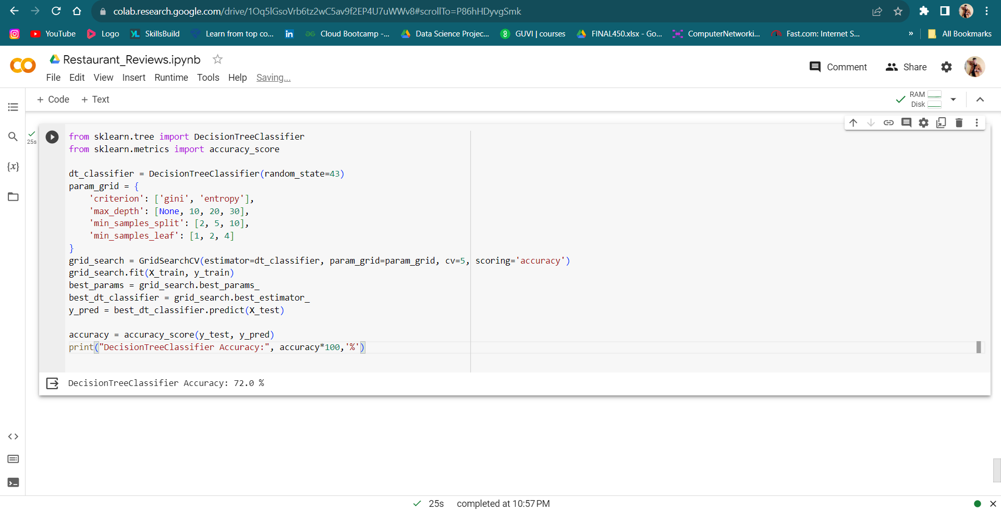
RESULTS
Decision Tree Classifier Accuracy =72.0%

Slide 18
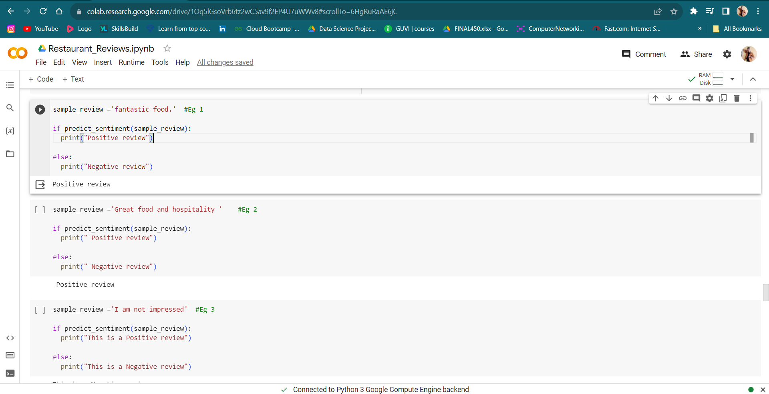
RESULTS
Some Examples

Slide 19
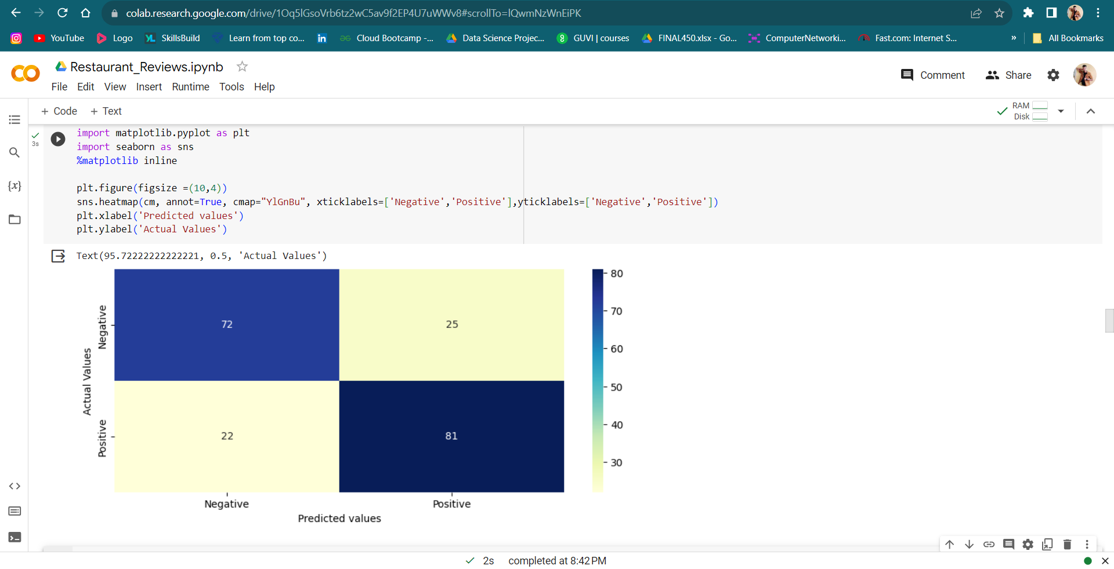
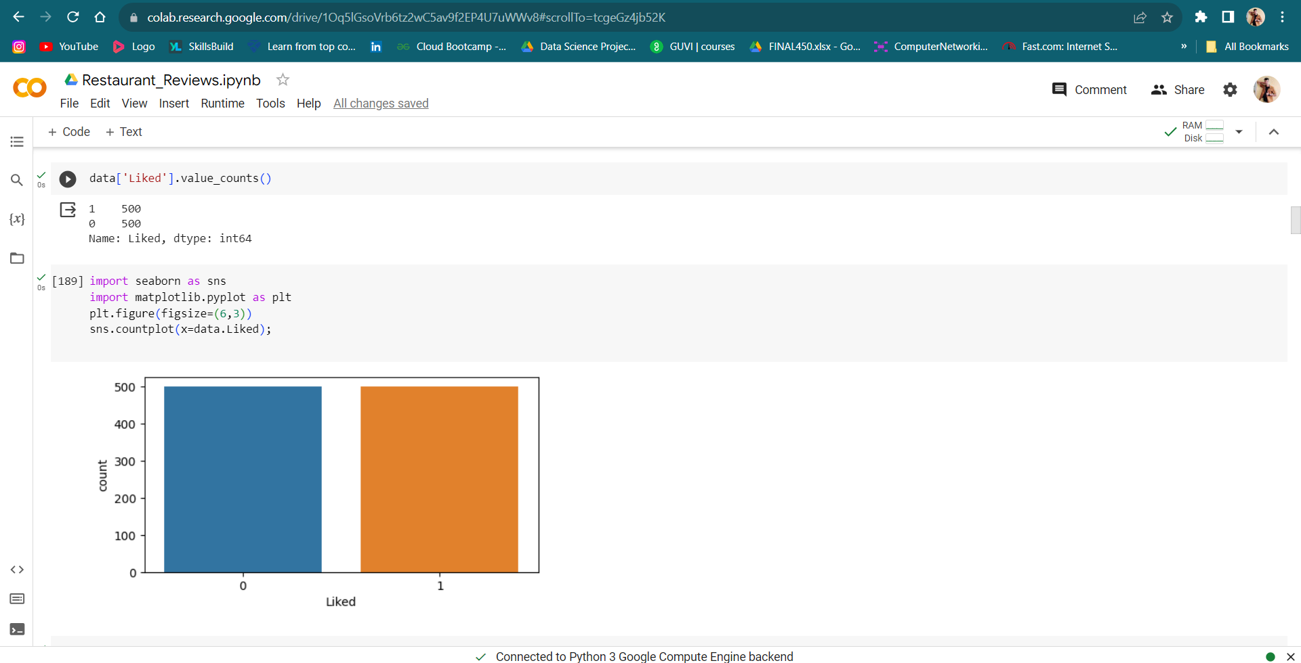
GRAPS AND HEATMAP

Slide 20
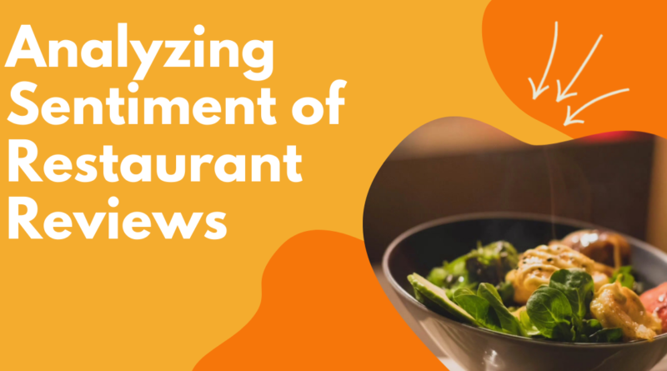


Links:-
Content
Put Your Screenshot
Here
Get 15% discount from regular price
Coupon Code:
FREEBUNDLE15
Apply this coupon code during sign up
Download PowerPoint templates and save hours of work.
SUBSCRIBE NOW
Easy to use
Fully customizable
Cutting edge designs
Visit slidemodel.com
GitHub:- https://github.com/paritosh22/Sentiment-Analysis-of-Restaurent-Reviewst.git
Colab:- https://colab.research.google.com/drive/1Oq5lGsoVrb6tz2wC5av9f2EP4U7uWWv8?usp=sharing
Notes:
You can safely remove this slide. This slide design was provided by SlideModel.com – You can download more templates, shapes and elements for PowerPoint from http://slidemodel.com/

Slide 21


